Slide 1
Home Credit Default Risk
Eric Huynh
Data Capstone 2

Slide 2
Problem & Overview:
Countless numbers of loan/credit applications are refused each day by financial institutions
Due to monetary risk of credit defaults by clients
Financial institutions are stringent on qualifications to request large loans.
Limits applicants to only clients that already have a strong credit record.
Forces clients with little to non-existent credit history to rely on unreliable lenders to meet their financial needs.

Slide 3
Solution and Objective
Certain financial institutions have strived to expand the financial inclusion to those with insufficient or non-existing credit histories.
Utilize a variety of alternate data to gauge and measure the clients’ risk profiles without relying on the conventional methods.
Objective:
Draw reliable variables from the alternate data that can reliably gauge a clients’ risk profile.
Develop a predictive model that can accurately classify clients as high-risk or low-risk for credit loans

Slide 4
Potential Clients
Financial Institutions:
Expand their loans applicant pool by measuring new clients’ risk profile with alternate data.
Higher yields both short-term and long-term as positive financial experience will bring in reoccurring clients.
Loan Applicants:
Understand alternative attributes that can help them develop towards becoming a low-risk applicant despite insufficient credit histories.
Also applicable for anyone applying for a larger loan they may not currently qualify for under traditional requirements.

Slide 5
Data from Kaggle Competition
Training Data:
Consists of 307,511 unique client IDs and 122 categories.
6 Supplemental Datasets (only 4 used):
“bureau.csv” – information regarding all previous credits
“credit_card_balance.csv” – previous credit information with Home Credit
“installments_payments.csv” – repayment history for approved credit by Home Credit
“previous_application.csv” – all previous applications made to Home Credit
300+ heterogenous mixture of both categorical and quantitative features

Slide 6
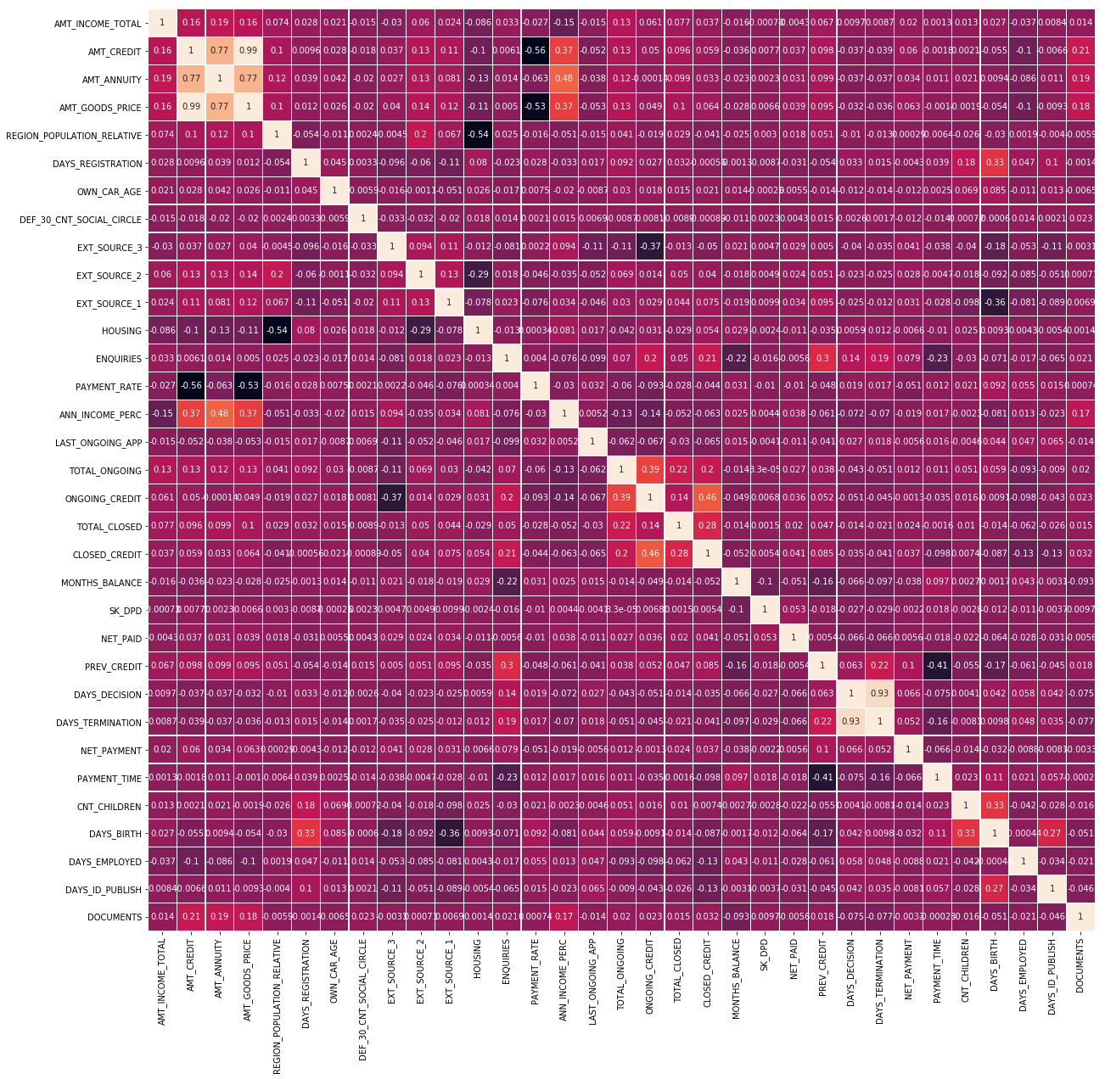
Numerical Correlation
Key Points:
Strong correlation between DAYS_TERMINATION and DAYS_DECISION which indicates multicollinearity.
DAYS_DECISION removed
Strong correlation between AMT_CREDIT, AMT_ANNUITY, and AMT_GOODS_PRICE which indicates multicollinearity.
AMT_GOODS_PRICE removed
There was a total of 11 correlations, only 2 were acted on

Slide 7
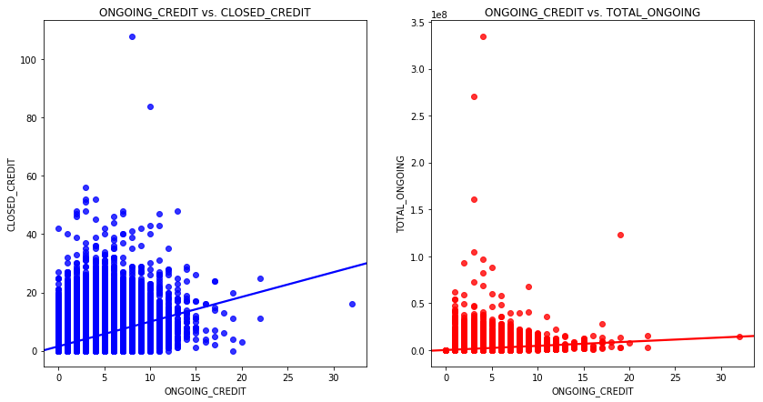
Correlation
Key Points:
Despite the “positive correlations” seen in these two sets of variables, the distribution of the data appears fairly random.
This is likely due to the extreme values despite the outliers already being scaled downward.

Slide 8
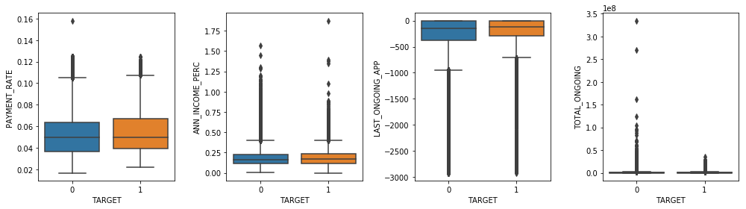
Numerical Variables as Predictors
Key Points:
Visual representations of the data were obscure and difficult to draw insights from.
Instead, I chose to utilize inferential statistics to find statistically significant differences between target and non-target groups.

Slide 9
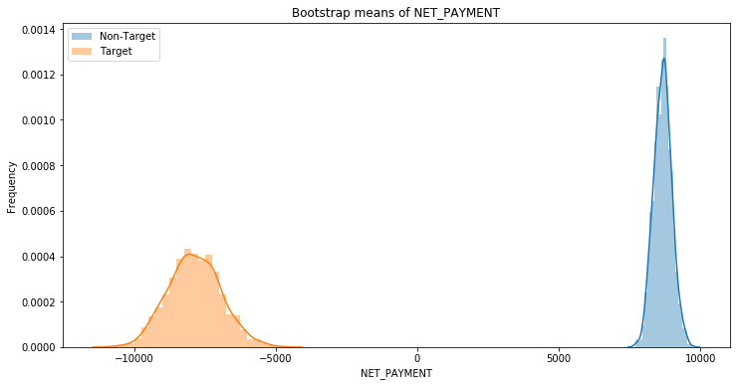
Inferential Statistics
Two-sided t-test (p-value) and Frequentist bootstrap approach (95% confidence interval)
Applied to numerical and binary categorical data.
5 variables failed to show statistically significant differences:
OWN_CAR_AGE, ENQUIRIES, SK_DPD, DAYS_TERMINATION, VALID_MOBILE

Slide 10
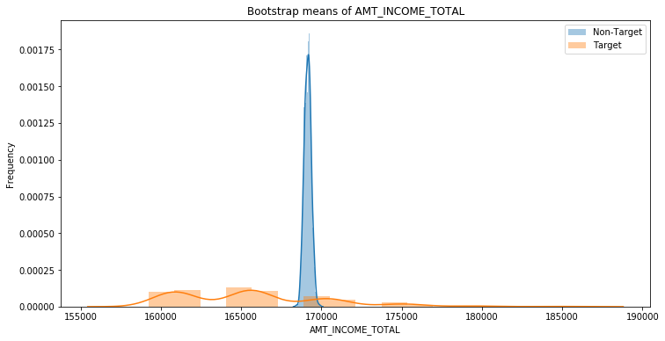
Total Income
Non-target:
The means of the bootstrap samples are tightly fit around a small range
Target:
The distribution of the bootstrap samples are right skewed and multi-peaked.

Slide 11
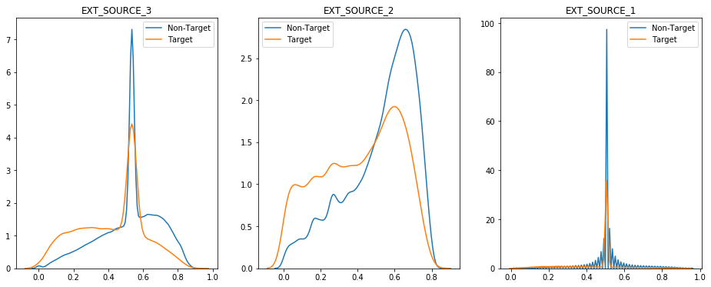
External Source Scoring
External Source Scoring shows the highest magnitude of correlation.
In the training data, the target group has a higher population of lower scores than the non-target group.

Slide 12
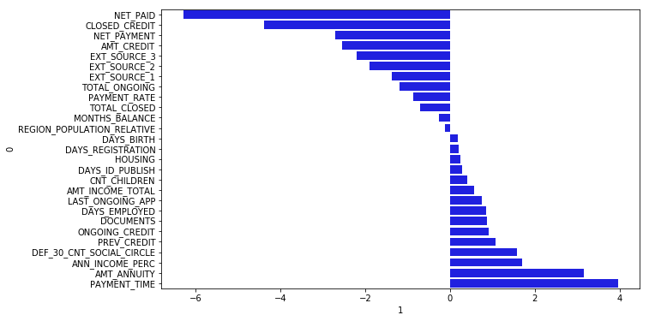
Numerical Feature Importance

Slide 13
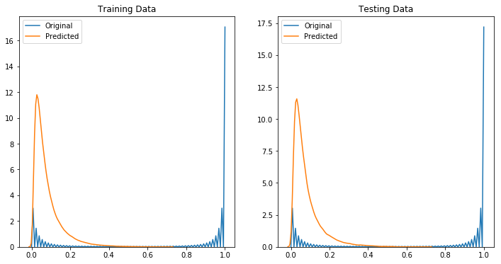
Logistic Regression

Slide 14
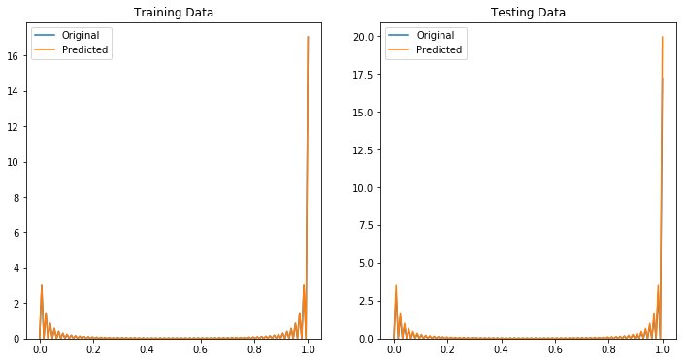
Decision Tree Classifier

Slide 15
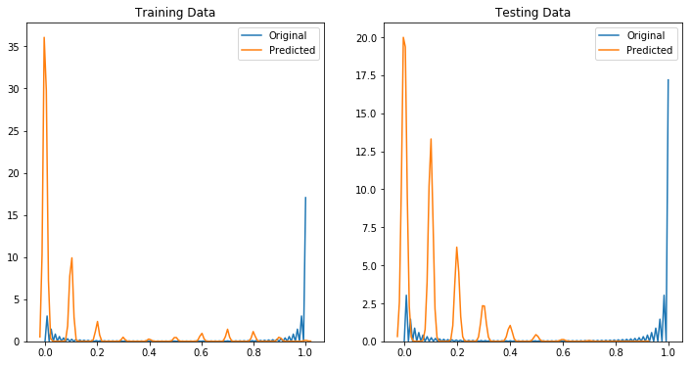
Random Forest Classifier

Slide 16
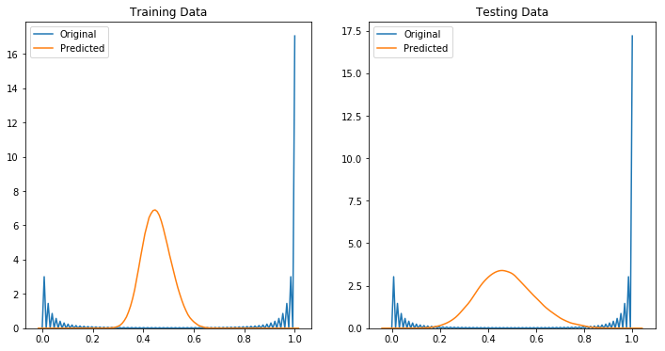
LinearSVC (Support Vector Classification)

Slide 17
Metric Scoring
Scoring was performed via Area Under the ROC Curve.
Of the four attempted algorithms, LogisticRegression and LinearSVC outperformed the other two.
LogisticRegression performed slightly better than the LinearSVC.
Currently, the highest score is 0.693.

